Slide 2
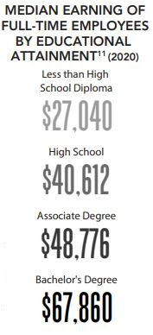
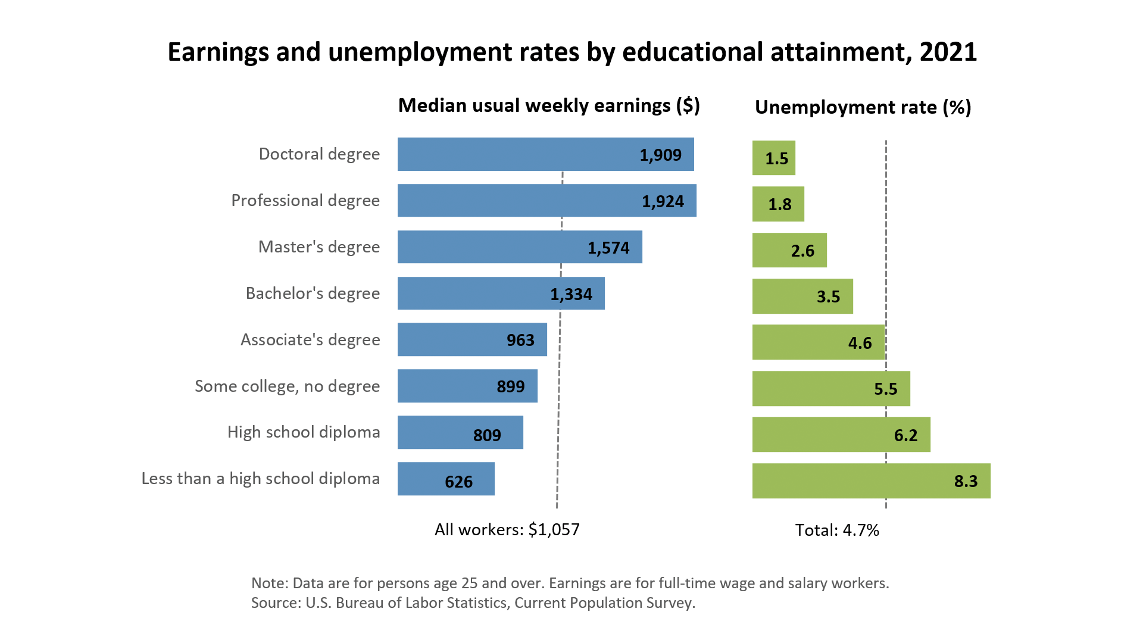
Why is education important?
Increased Earnings
Skilled Workforce
Higher Quality of Life
More Community Participation

Slide 3
Mid’s History
Founded in 1965
Michigan’s 25th Community College
Two Campuses + Online
In-District Service Area
Beaverton, Clare, Farwell, Gladwin, Harrison,
and Mt. Pleasant Schools
Serve all of mid-Michigan, from Bad Axe to Big Rapids
Focused on student learning and community connections
WE DEVELOP KNOWLEDGE AND ABILITY TO
EMPOWER LEARNERS AND TRANSFORM COMMUNITIES.

Slide 4
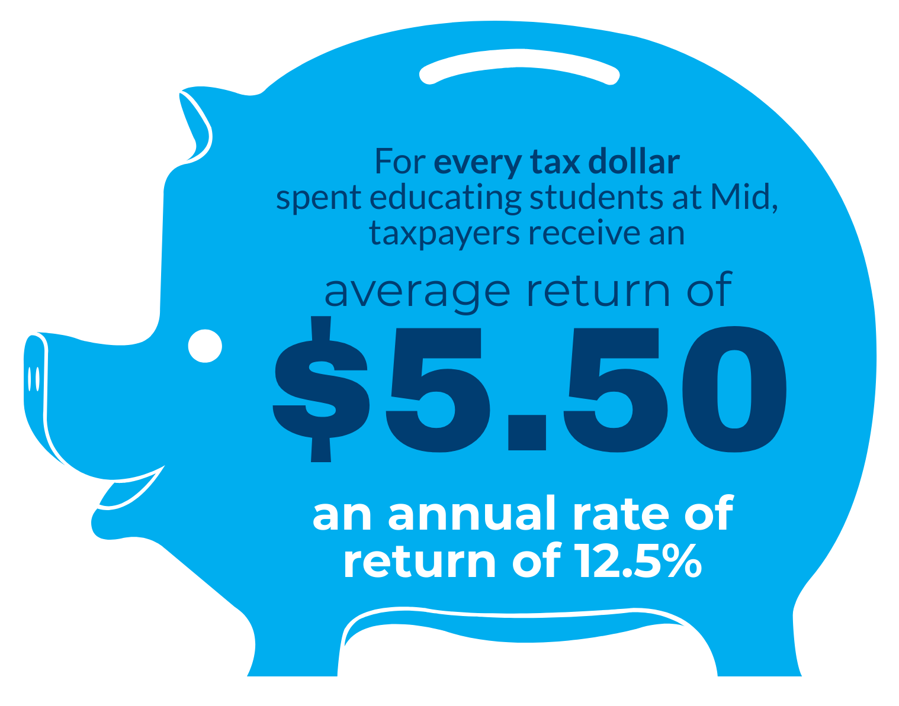
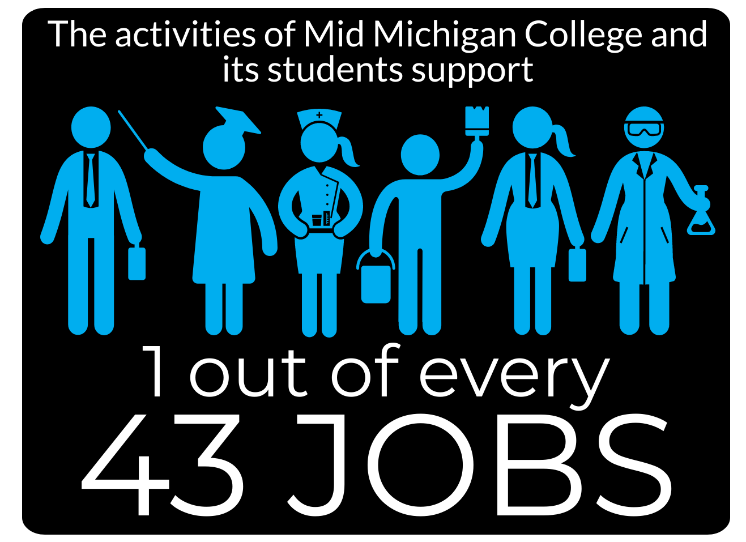
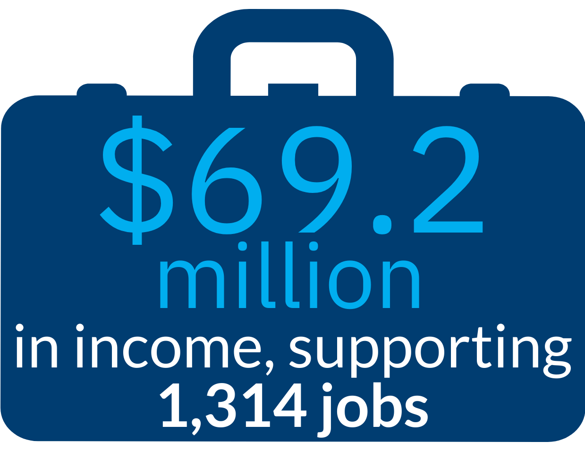
Mid By The Numbers
Mid has the 2nd lowest millage rate in the state
1.22 set in 1965 with Mid’s original millage vote
2.35 is the state average for community colleges
In-District Tuition $142
Beaverton, Clare, Farwell, Gladwin, Harrison, and Mt. Pleasant School Districts + All Dual Enrolled Students
Out-District Tuition $237
Lower Cost + Aid + Support = Less Barriers

Slide 5
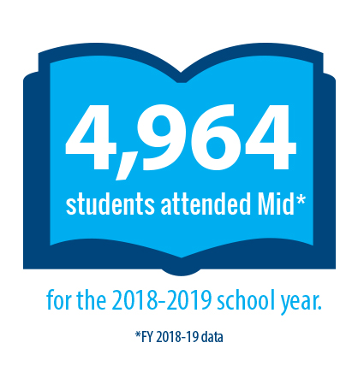
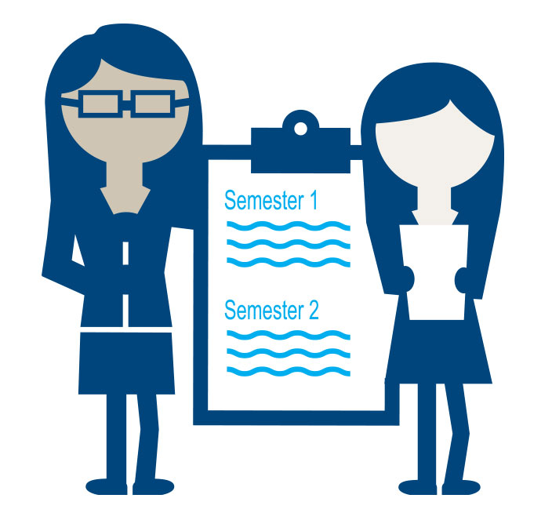
Open Door Philosophy
Nearly 100% of Applicants Accepted
Our value helps make college accessible
Tuition and fees at Mid are about half the cost of universities
Financial aid makes Mid even more affordable
Wide array of support services help students succeed
Library & Learning Services
Out-of-Classroom Support
Food Pantry
Mental Health & Wellness Services
Career Center
Developmental Courses
Dedicated Mid Mentor

Slide 6
Student Enrollment History

Slide 7
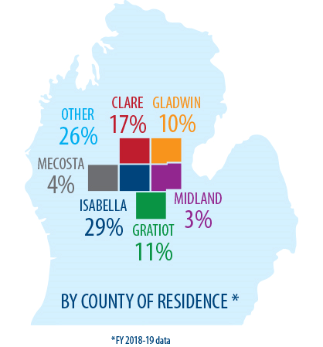
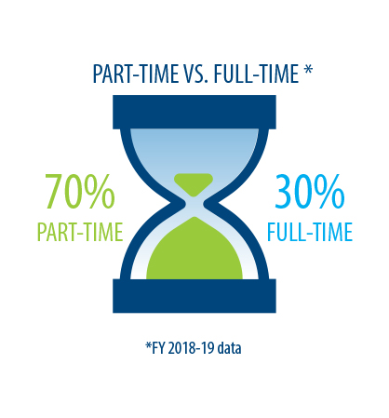
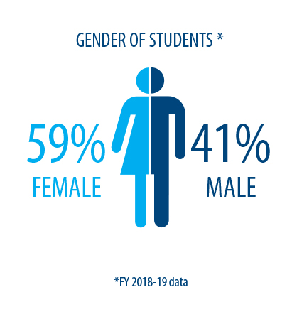
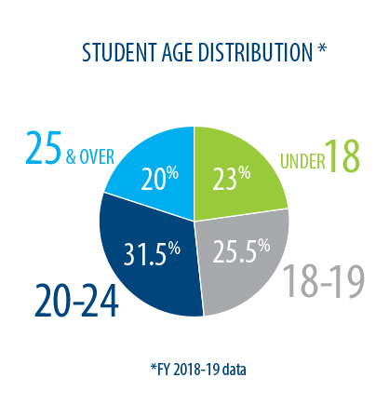
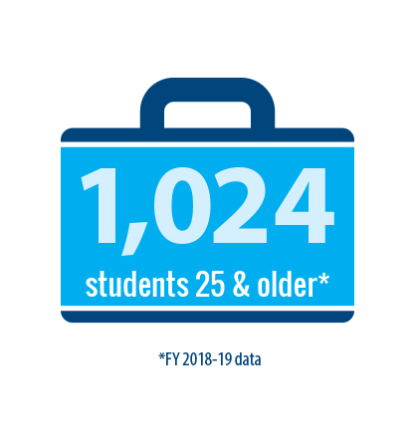
Student Profile

Slide 8
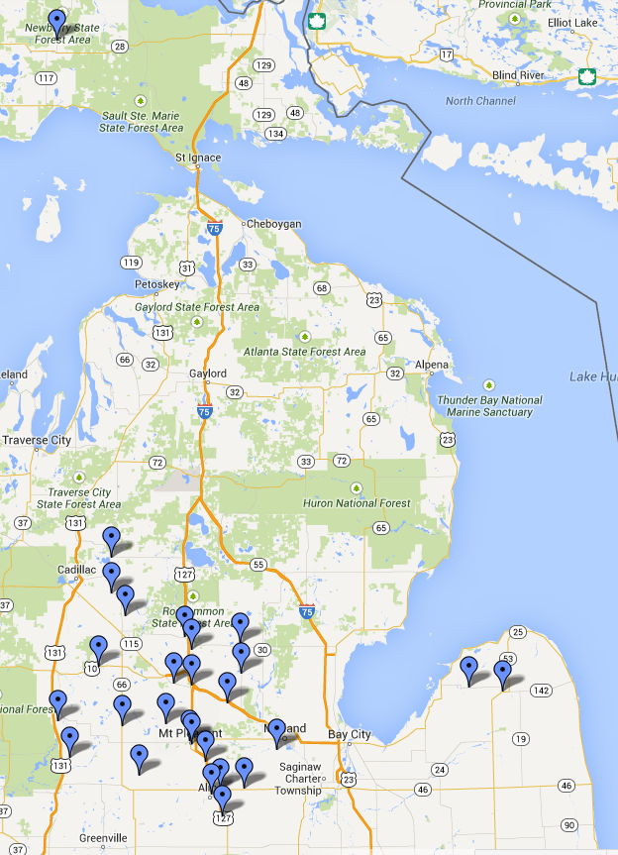
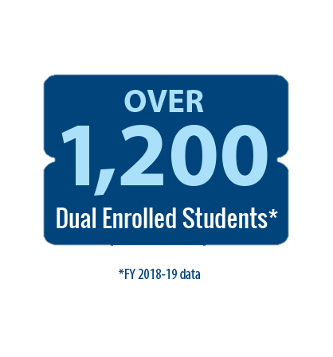
Dual Enrollment
Great opportunity for students
2009 – 300 students
2022 – 1,200 students
Many different ways to dual
Enhanced
Single Course
Online
On High School Campus
On Mid’s Campuses
Early College
Complements other efforts with K-12 partners

Slide 9
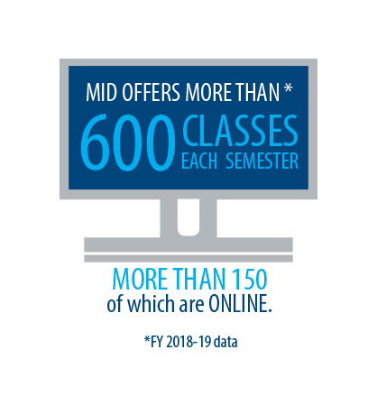
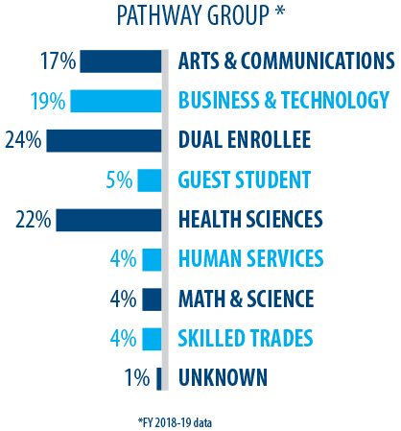
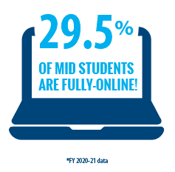
Academics
Over 80 Programs & Pathways
Career-Ready &
Transfer-Focused Options
Certificates, Training Credentials, & Associate Degrees
Fully-Online Credentials
Mid has over 50 Programs & Pathways that are 50%+ online.
Laddered Learning and Credit for Prior Learning Opportunities
Students can turn skills into credits and ladder credits from certificates to associate degrees.

Slide 10
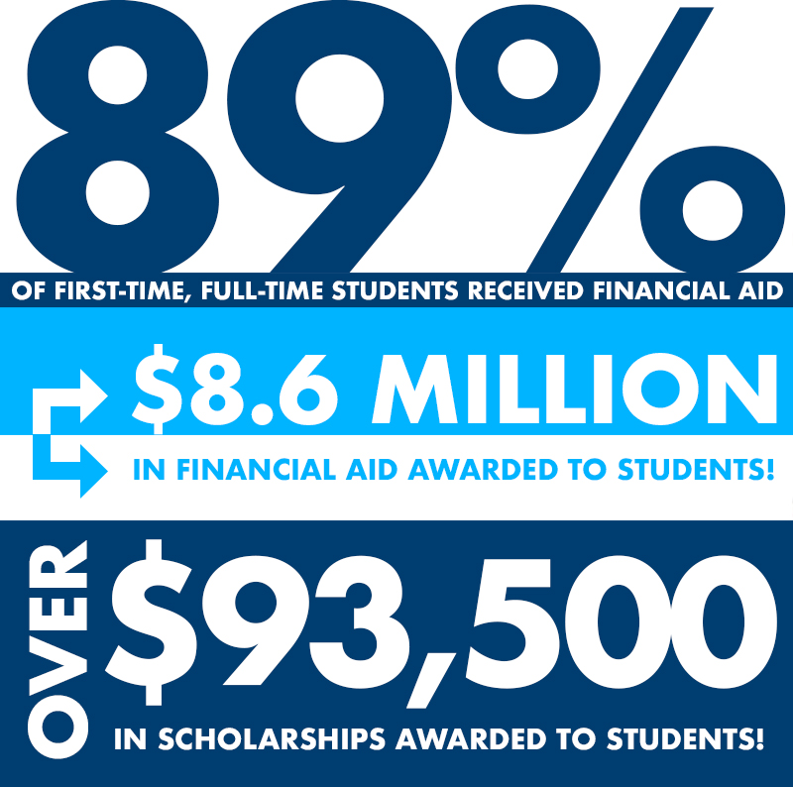
Financial Aid
Pell Grants
TIP (Tuition Incentive Program)
Futures for Frontlines
Michigan Reconnect
Michigan Achievement Scholarship
Mid Scholarships
Private Scholarships

Slide 11
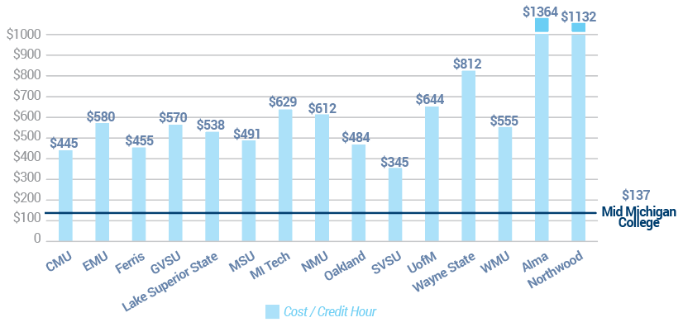
Tuition Comparison
Tuition Rates (2020-2021)

Slide 12
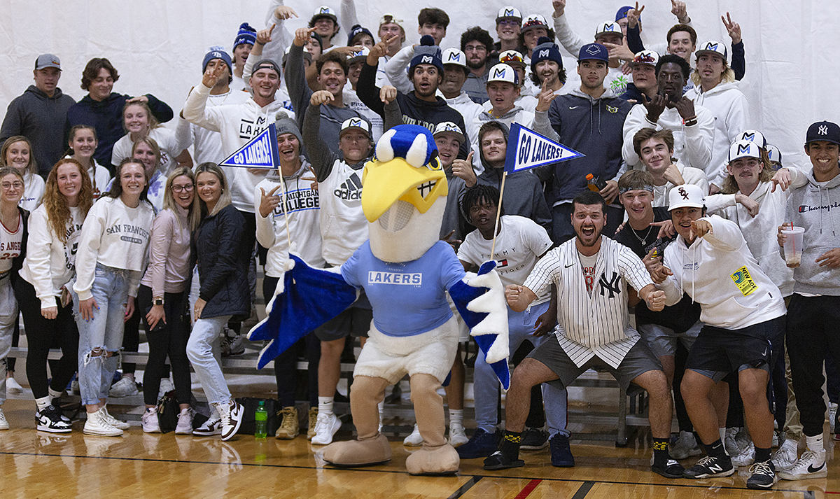
Laker Athletics
Seven College-Level Teams
Men’s & Women’s Basketball
Men’s & Women’s Bowling
Men’s & Women’s Cross Country
Baseball & Softball
Co-ed Clay Target Shooting
Co-ed Bass Fishing
Over 100 Student Athletes
Compete in the MCCAA & NJCAA DII
Mid’s Mascot Harry the Heron

Slide 13
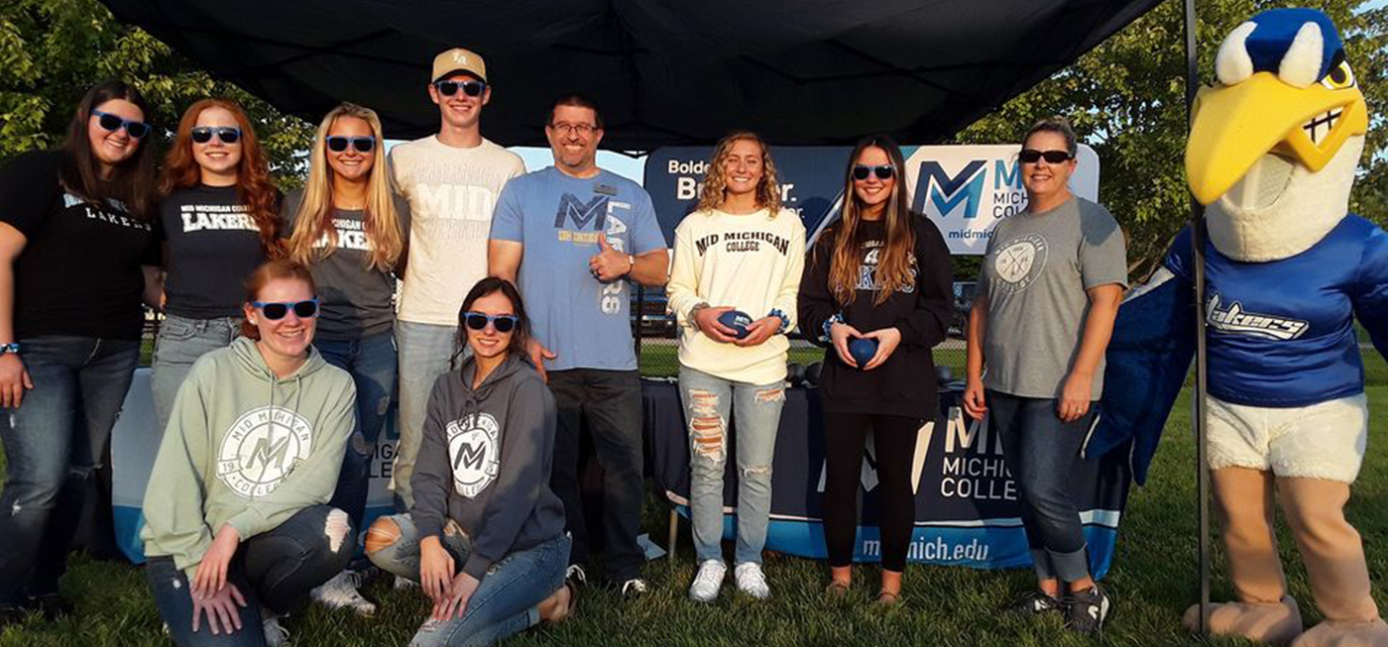
Community Connections
Long history of supporting the community
Volunteering
Sponsorships
Community Events
Training
Professional Development
Small Business Development Center
Community Education
Lifelong Learning Classes
Online Personal Interest Classes

Slide 14
Questions?

